Slide 1
CHAPTER 7 MANAGING GROWTH AND TRANSITION
Chapter Objectives
After completing this chapter, students will be able to:
Identify factors that affect business growth,
Understand business expansion strategies,
Know & internalize business ethics & social responsibilities.

Slide 2
7.2 Timmons Model of Entrepreneurship
What key aspects does an entrepreneur need to manage to start and grow a business?
To answer this question, we used Timmons basic model of entrepreneurship as indicated in Figure 7.1. This model identified the internal and external factors that determine the growth of business.

Slide 3
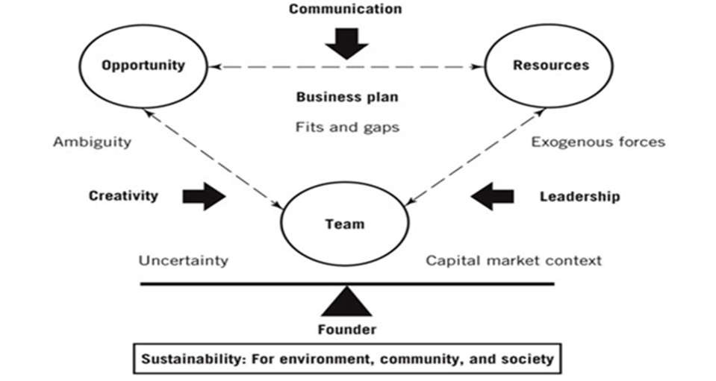

Slide 4
Jeffry Timmons (2006) developed the Timmons model of entrepreneurship through his doctoral thesis.
Further research and case studies have since enhanced the model, which works as a guide for entrepreneurs to increase their chances of success.
According to Timmons, success in creating a new venture is driven by a few central themes that dominate the dynamic entrepreneurial process: it takes opportunity, a lead entrepreneur and an entrepreneurial team, creativity, being careful with money, and an integrated, holistic, sustainable and balanced approach to the challenges ahead.
These controllable components of the entrepreneurial process can be assessed, influenced and altered.

Slide 5
According to the model, for an entrepreneur to create a successful venture, they must balance three key components indicated earlier as elaborated here below:
Opportunities: rather than developing a perfect business plan, Timmons suggests that the entrepreneur’s first and most important step is to identify and evaluate a solidly viable market opportunity, where after the business plan and funding will follow.
Problems in the environment become opportunities for entrepreneurs.

Slide 6
Cont…
As stated earlier, Timmons model dictates that the entrepreneurial process does not start with business plan, money, strategy, networks or team.
Opportunities are more essential than the talent or competence of lead entrepreneur and the team because a right opportunity identified ensures long- term success of the business.
An excellent idea is found when product or services could be positioned to create or add values to customer, remains attractive, durable and timely.

Slide 7
2.Teams: once an opportunity has been identified, it is critical to gather a good team of people to unlock the potential of the opportunity.
Team members do have defined roles.
Likewise, people in the team have different roles, weaknesses and strengths.
A highly effective lead entrepreneur should be able to put the best talent together after identifying the opportunity and gathering required resources.
The sizes and the background of the team are contingent upon the size and nature of opportunity.
According to Timmons model, a good team can lead to great success and a badly formed team can waste great idea which is disaster to any form of business.

Slide 8
Cont…
The two major roles of the team, relative to the other critical factors are:
Removing the ambiguity and uncertainty of the opportunity by applying creativity (inventiveness).
Providing leadership to manage the available resources in the most effective manner by interacting with external forces and the capital market context that keeps changing constantly.
3. Resources: finding and managing appropriate resources requires different skills than finding and managing good people, but it is equally important for eventual success.
Resources may include tangible and intangible resources.
Knowledge, goodwill, information, etc., are intangible resources.
Buildings, land, information technology, human resource, money, etc., are tangible resources.

Slide 9
Cont…
As stated earlier, the Timmons model stimulates the focus on opportunities rather than threats or limitations.
It must be acknowledged that the model sees the creation of a venture as an evolutionary process.
The three critical factors of entrepreneurship in the model (opportunities, team and resources) are therefore not easy to manage separately; changes in one factor have a strong influence on the other factors.

Slide 10
7.3 New Venture Expansion Strategies
7.3.1 Introduction
Business expansion is a stage of a company's life that is troubled with both opportunities and threats.
Growth causes a variety of changes, all of which present different managerial, legal, and financial challenges.
Growth means that new employees will be hired who will be looking to the top management of the company for leadership.
Growth means that market share will expand, calling for new strategies for dealing with larger competitors.
Growth also means that additional capital will be required, creating new responsibilities to shareholders, investors, and institutional lenders.
Thus, growth brings with it a variety of changes in the company's structure, needs, and objectives.

Slide 11
7.3.2 Methods of Growth
Common routes of small business expansion include the following common options:
Growth through acquisition of another existing business (almost always smaller in size),
Licensing of intellectual property to third parties, (license for the use of certain innovative models on fee basis may be given to certain companies).
This is very common for Software products.
Establishment of business agreements with distributorships and/or dealerships,
public stock offerings (selling shares to investors and to the general public),
Employee stock ownership plans (entrepreneurs may give/sell shares to employees as incentive for motivation.

Slide 12
7.3.3 The Ansoff Matrix – Growth Strategy
What is our business growth strategy in relation to new or existing markets and products?
The Ansoff Matrix is a strategic-planning tool that provides a framework to help executives, senior managers, and marketers devise strategies for future growth.
It is named after Russian American Igor Ansoff, who came up with the concept.
Ansoff suggested that there were effectively only two approaches to developing a growth strategy; through varying what is sold (product growth) and who it is sold to (market growth).

Slide 13
Market penetration / consumption –
The firm seeks to achieve growth with existing products in their current market segments, aiming to increase market share.
This is a low risk strategy because of the high experience of the entrepreneur with the product and market.
2. Market development –
The firm seeks growth by pushing its existing products into new market segments.
Market development has medium to high risk.
3. Product development –
the firm develops new products targeted to its existing market segments.
This alternative growth strategy is characterized by medium to high risk due to lack of experience about the new product.
4. Diversification – the firm grows by developing new products for new markets. This is high risk option as entrepreneurs do not have experience about the product and the market.

Slide 14
7.3.4 Expansion Issues
Whatever method a company chooses to utilize to expand—and whatever guiding strategy it chooses to employ its owners will likely face a combination of potentially frustrating issues as they try to grow their business in a smooth and productive manner.
Growth means understanding, adjusting to, and managing a whole new set of challenges in essence, a very different business.
Growing Too Fast
This is a common disease that strikes ambitious and talented entrepreneurs who have built a flourishing business that meets a strong demand for a specific set of goods and/or services.
Success is wonderful, of course, but rapid growth can sometimes overwhelm the ill-prepared business owner.
Companies growing at hyper-speed sometimes pay a steep price for their success. According to management experts, controlling fast-track growth and the problems that come with it can be one of the most frightening tasks an entrepreneur will face.
This problem most often strikes on the operational end of a business.

Slide 15
X)Record keeping and Other Infrastructure Needs
It is essential for small businesses that are undergoing expansion to establish or update systems for monitoring cash flow, tracking inventories and deliveries, managing finances, tracking human resources information, and myriad other aspects of the rapidly expanding business operation.
In addition, growing enterprises often have to invest in more sophisticated communication systems in order to provide adequate support to various business operations.
XI)Expansion Capital
Small businesses experiencing growth often require additional financing.
Businesses should revise their business plan on an annual basis and update marketing strategies accordingly so that you are equipped to secure financing under the most advantageous terms possible.

Slide 16
XII) Personnel Issues
Growing companies will almost always have to hire new personnel to meet the demands associated with new production, new marketing campaigns, new recordkeeping and administrative requirements, etc.
Careful hiring practices are always essential, but they are even more so when a business is engaged in a sensitive period of expansion.
Business expansion also brings with it increased opportunities for staff members who were a part of the business in its early days.
Entrepreneurs who pursue a course of ambitious expansion may find that some of their most valuable and well-liked employees decide to instead take a different path with their lives.

Slide 17
XIII) Customer Service
Good customer service is often a significant factor in small business success, but ironically it is also one of the first things that tends to fall by the roadside when business growth takes on a hectic flavour.
And sometimes you have a hard time getting back to clients in a timely fashion.
So the very customer service that caused your growth in the first place becomes difficult to sustain.
Under such scenarios, businesses not only have greater difficulty retaining existing clients, but also become less effective at securing new business.
A key to minimizing such developments is to maintain adequate staffing levels to ensure that customers receive the attention and service they demand (and deserve).

Slide 18
XIV) Disagreements among Ownership
On many occasions, ownership arrangements that functioned fairly effectively during the early stages of a company's life can become increasingly problematic as business issues become more complex and divergent philosophies emerge.
One founder may want to devote resources to exploring new marketing niches, while the other may be convinced that consolidation of the company's presence in existing markets is the way to go.
In such instances, the departure of one or more partners may be necessary to establish a unified direction for the growing company.

Slide 19
XV) Family Issues
Embarking on a strategy of aggressive business expansion typically entails an extensive sacrifice of time and often of money on the part of the owner (or owners).
But as many growing companies especially those founded by younger entrepreneurs, are established at a time when all of the cofounders are either unmarried or in the early stages of a marriage.
As the size of the company grows, so does the size of the cofounder’s family.
Cofounders with young children may feel pressure to spend more time at home, but their absence will significantly cut their ability to make a continuous, valuable contribution to the company's growth.
Entrepreneurs thinking a strategy of business growth, then, need to decide whether they are willing to make the sacrifices that such initiatives often require.

Slide 20
XVI) Transformation of Company Culture
Owners are ultimately the people that are most responsible for communicating those values to employees.
But as staff size increases, markets grow, and deadlines proliferate, that responsibility gradually falls by the edge and the company culture becomes one that is far different from the one that was in place and enjoyed just a few short years ago.
Entrepreneurs need to make sure that they stay attentive to their obligations and role in shaping company culture.

Slide 21
XVII) Changing Role of Owner At The Initial State
You have few employees; you're doing lots of things yourself.
But when a company experiences its first real surge of growth, it's time for you to change what you do.
You need to become a CEO—that is, the leader, the strategic thinker, and the planner—and to delegate day-to-day operations to others.
Moreover, as businesses grow in size they often encounter problems that increasingly require the experience and knowledge of outside people.

Slide 22
7.3.5 Choosing not to Grow
Small business owners choose not to expand their operations even though they have ample opportunity to do so.
Many entrepreneurs would rather limit growth than give up those satisfactions.
Other successful small business owners, meanwhile, simply prefer to avoid the headaches that inevitably occur with increases in staff size, etc.
And many small business owners choose to maintain their operations at a certain level because it enables them to devote time to family and other interests that would otherwise be allocated to expansion efforts.

Slide 23
7.4 Business Ethics and Social Responsibility
Learning Objectives
•Define and discuss the three main theories of corporate social responsibility (CSR).
•Explain why CSR ultimately benefits both companies and their stakeholders.
7.4.1 Introduction
Business organizations, as established by their entrepreneurs, are expected to do their businesses in a sustainable and ethical manner.

Slide 24
7.4.2 Three Approaches to Corporate Responsibility
According to the traditional view of the corporation, it exists primarily to make profits supported by stockholder theory.
Broadly, there are three theoretical approaches to these new responsibilities:
1.Corporate social responsibility (CSR)
2.The triple bottom line
3.Stakeholder theory

Slide 25
1. Corporate Social Responsibility (CSR)
The title corporate social responsibility has two meanings.
First, it’s a general name for any theory of the corporation that emphasizes both the responsibility to make money and the responsibility to interact ethically with the surrounding community.
Second, corporate social responsibility is also a specific conception of that responsibility to profit while playing a role in broader questions of community welfare.
For its definition, CSR is a philosophy in which the company’s expected actions include not only producing a reliable product, charging a fair price with fair profit margins, and paying a fair wage to employees, but also caring for the environment and acting on other social concerns.
As a specific theory of the way corporations interact with the surrounding community and larger world, corporate social responsibility (CSR) is composed of four obligations:

Slide 26
1.The economic responsibility to make money
2. The legal responsibility to adhere to rules and regulations
3. The ethical responsibility to do what’s right even when not required by the letter or spirit of the law.
4. The humanitarian responsibility to contribute to society’s projects even when they’re independent of the particular business.

Slide 27
2.The Triple Bottom Line
The triple bottom line is a form of corporate social responsibility dictating that corporate leaders formulate bottom-line results not only in economic terms (costs versus revenue) but also in terms of company effects in the social realm, and with respect to the environment.
The notion of sustainability is very specific.
At the intersection of ethics and economics, sustainability means the long-term maintenance of balance.
As elaborated by here below how the balance is defined and achieved economically, socially, and environmentally:

Slide 28
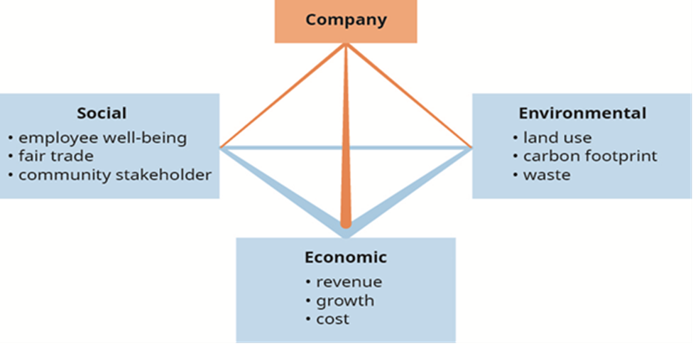

Slide 29
According to the triple-bottom-line model, corporations have a responsibility to create business plans allowing stable and long action.
Sustainability as a virtue means valuing business plans that may not lead to quick riches but that also avoid disastrous losses.

Slide 30
Cont..
Social sustainability values balance in people’s lives and the way we live.
As the imbalances grow, as the rich get richer and the poor get both poorer and more numerous, the chances that society itself will collapse in anger and revolution increase.
In world history, however, such revolutions are quite common.
That doesn’t mean revolution is coming to our time’s developed nations.
It may indicate, however, that for a business to be stable over the long term, opportunities and subsequently wealth need to be spread out to cover as many people as possible.

Slide 31
Cont…
Social sustainability doesn’t end with dollars; it also requires human respect.
In today’s capitalism, many see—and the perception is especially strong in Europe a world in which dignity has been stripped away from a large number of trades and professions.
Finally, social sustainability requires that corporations as citizens in a specific community of people maintain a healthy relationship with those people.
Corporations should not affect the health of community negatively.

Slide 32
One deep difference between corporate social responsibility and the triple bottom line is cultural.
The first is more American, the second European.
Americans, accustomed to economic progress, tend to be more comfortable with, and optimistic about, change.
Collectively, Americans want business to transform the world, and ethical thinking is there (hopefully) to help the transformations maximize improvement across society.
Europeans, accustomed to general economic decline with respect to the United States, view change much less favourably.
Their inclination is to slow development down, and to keep things the same as far as possible.
This outlook is naturally suited to sustainability as a guiding value.

Slide 33
Stakeholder Theory
Stakeholder theory, which has been described by Edward Freeman and others, is the mirror image of corporate social responsibility.
Instead of starting with a business and looking out into the world to see what ethical obligations are there, stakeholder theory starts in the world.
By contrast, a stakeholder theorist begins with those living in the surrounding community who may find their environment poisoned, and begins to talk about business ethics by insisting that they have a right to clean air and water.

Slide 34
Cont..
Therefore, they’re stakeholders in the company and their voices must contribute to corporate decisions.
It’s true that they may own no stock, but they have a moral claim to participate in the decision-making process.
This is a very important point. At least in theoretical form, those affected by a company’s actions actually become something like shareholders and owners.
Because they’re touched by a company’s actions, they have a right to participate in managing it.
The collective bottom line is the summed effect of a company’s actions on all stakeholders.
At every turn, stakeholders are treated (to some extent) like shareholders, as people whose interests need to be served and whose voices carry real force.
In many cases transparency is an important value for those promoting stakeholder ethics.

Slide 35
7.4.3 Business Ethics Principles
There are certain universal ethical principles that managers of enterprises must adhere to.
Ethical values, translated into active language establishing standards or rules describing the kind of behaviour an ethical person should and should not engage in, are ethical principles.
The following list of principles incorporates the characteristics and values that most people associate with ethical behaviour.
1.Honesty.
2’ Integrity.
3. Promise-Keeping & Trustworthiness.

Slide 36
4. Loyalty.
5. Fairness. Ethical executives are fair and just in all dealings; they do not exercise power arbitrarily, and do not use overreaching nor offensive means to gain or maintain any advantage nor take undue advantage of another’s mistakes or difficulties.
6. Concern for Others
7. Respect for Others
8. Law Abiding. Ethical executives abide by laws, rules and regulations relating to their business activities.
9. Commitment to Excellence
10. Leadership
11. Reputation and Morale:-Ethical executives seek to protect and build the company’s good reputation and the morale of its employees by engaging in no conduct that might undermine respect and by taking whatever actions are necessary to correct or prevent inappropriate conduct of others.
12. Accountability.

Slide 37
End of chapter 7

Slide 38
Quiz 1:-
2. What is the difference b/n The Ansoff Matrix – Growth Strategy and Timmons Model of Entrepreneurship with practical example?

